Slide 1
CFD in EDISON Web Portal
PRAGMA26
Applications of Cyber-Learning in CFD & Nanotechnology
Seonguk Lee and Chongam Kim
Seoul National University, Korea
2014. 4. 9.

Slide 2
Contents
Introduction
EDISON_CFD
Platform
Simulation programs and contents
Utilization in education

Slide 3
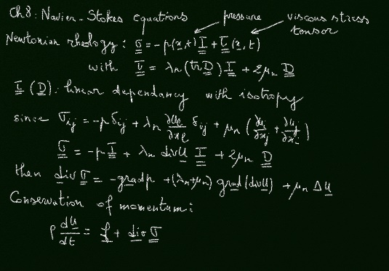
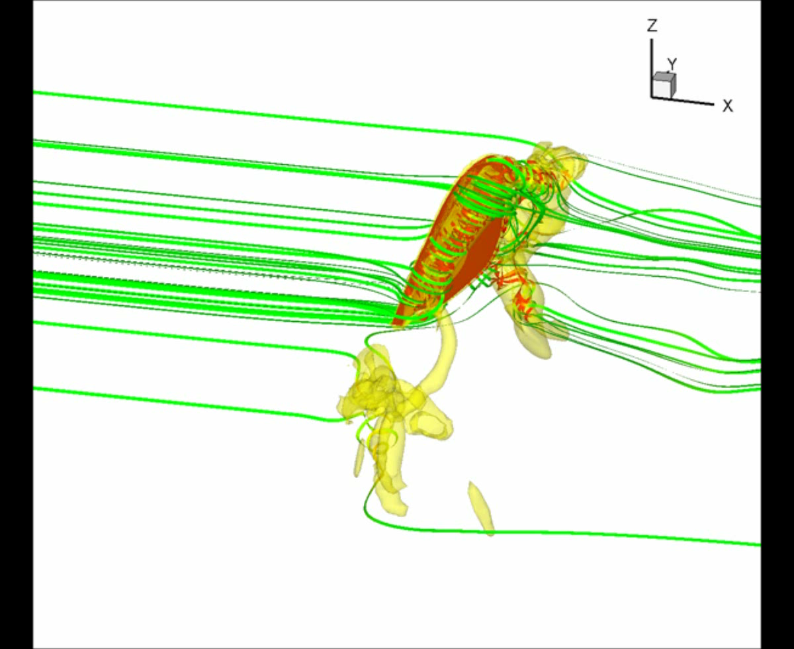

Introduction
Goals of EDISON_CFD
By utilizing simulation programs and contents
Attracts the students’ interests and develops students’ research spirits
Constructs a virtuous cycle between research and education in thermo-fluids engineering
Improves adaptability to the computational technology of students
Traditional Education
Education Utilizing Computation/Simulation

Slide 4
Introduction
Main Roles of Centers
EDISON main center
Building the EDISON platform
Developing a framework and middleware
Providing an infrastructure
EDISON_CFD professional center
Developing simulation programs and contents
Utilizing in education
Supporting user community
EDISON Main Center
Professional Center
(EDISON_CFD)
Developing EDISON platform
Managing users, drawing and supporting users’ requirements
Expanding and supporting community for each specialized field
Examining performances of processing business including annual performance
Developing simulation program and contents
Drawing improvements for utilizing education and research for each specialized field
Expanding community for each specialized field
Professional Center #2
(EDISON_Nanophysics)
Professional Center #3
(EDISON_Chem)

Slide 5



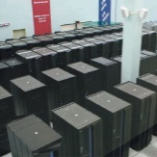
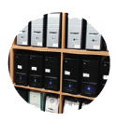
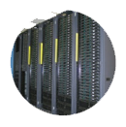
EDISON_CFD
EDISON_CFD, (EDucation-research Integration through Simulation On the Net for CFD)
Education/research-integrated environment for thermo-fluids engineering
Online environment based on e-Science technology
Possible to access the environment via the internet without the constraints of time and location
Provides simulation programs and contents
Various simulation programs on thermo-fluids engineering
Educational contents with simulations
Supports user community
For students, professors, and researchers
Simulation
Program
User
CFD
User
Community
Contents
e-Science
Environment

Slide 6
EDISON_CFD: Platform
Framework
For portal service and application
Manages the metadata of the simulation program
Provides an interface between the simulation components
E.g. Pre/postprocessor, simulation program, job scheduler, web GUI, etc.
Middleware
Manages hundreds of simulation jobs simultaneously with a distributed processing technology
Infrastructure
Provided and maintained by KISTI (Korea Institute of Science and Technology Information) Supercomputing Center
Browsers
Portal Service Framework
Application Framework
EDISON Middleware
Simulation/Job Manager, Solvers/Tools Manager, Physical/Virtualized Resource Manager
Infrastructure
Computing Resources, Storage, Network

Slide 7
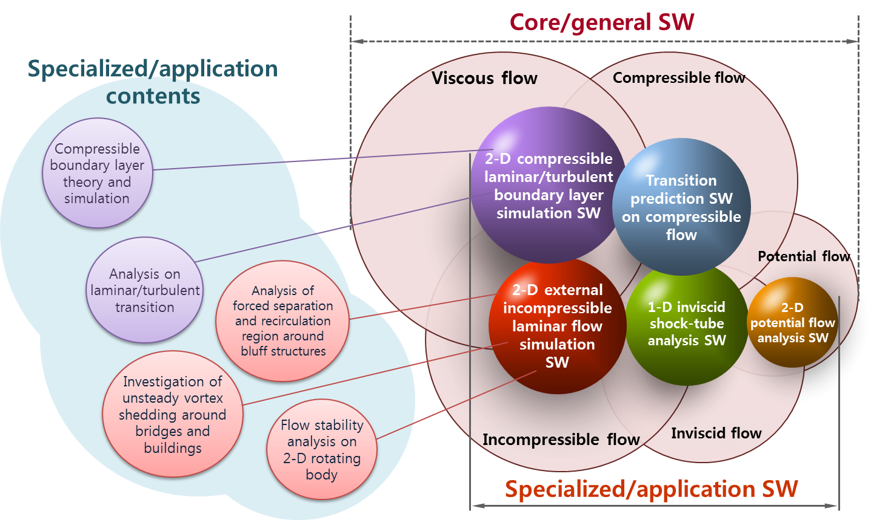
EDISON_CFD: Simulation Programs and Contents
Simulation Programs
General-purpose programs
Have a capability to solve a wide range of flow problems
Specialized programs
Focus on solving specific problems efficiently and accurately
Education Contents
Deal with a specific subject related to textbook
Have a connection to the simulation programs → Students accomplish a deeper understanding about the subject by carrying out simulations

Slide 8


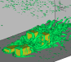
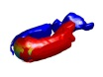
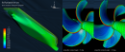
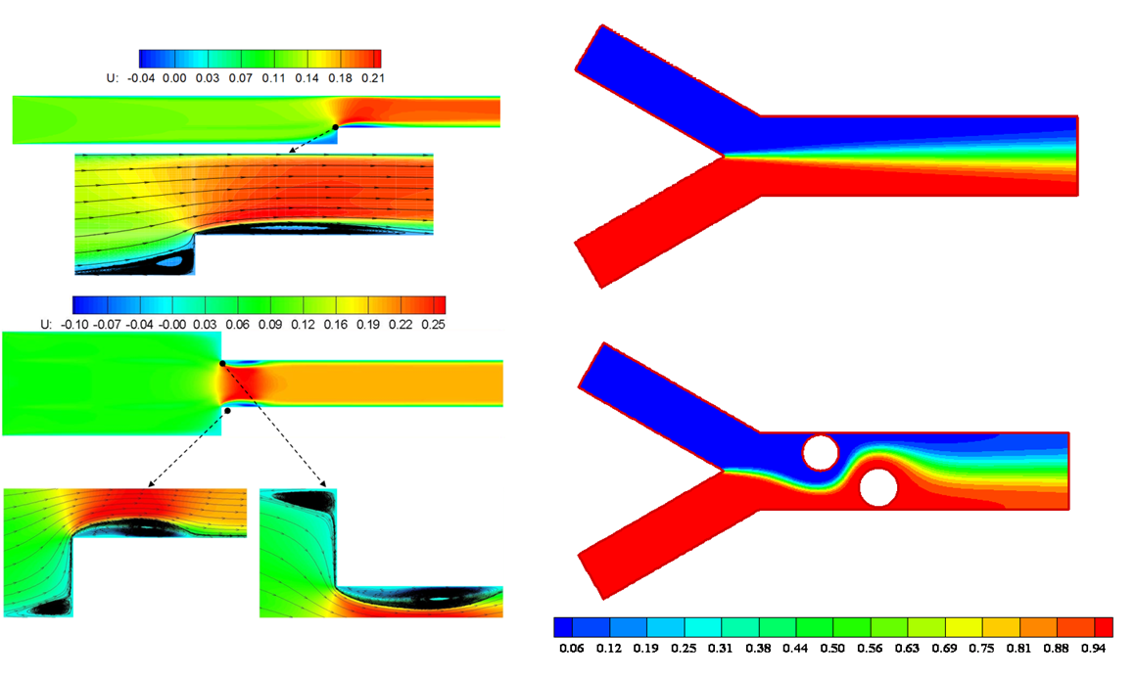
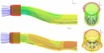


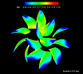
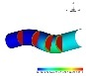
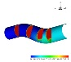
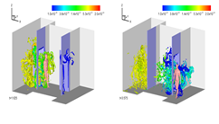
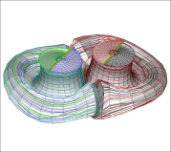
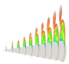
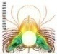
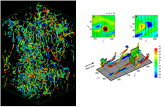
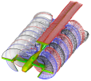
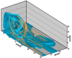
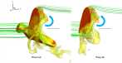
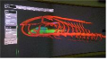
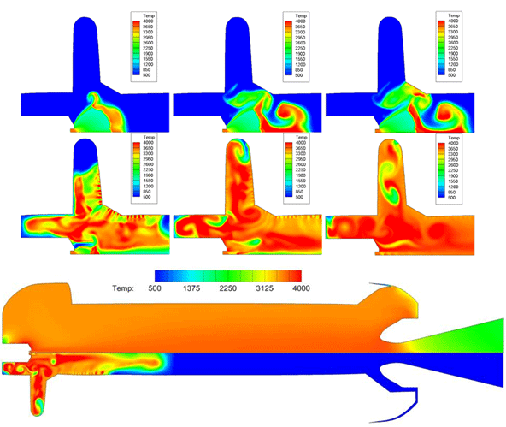
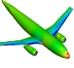
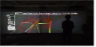
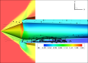
EDISON_CFD: Simulation Programs
Incompressible
Laminar Flow
Multiphase Flow
Duct Flow
Flow Optimization
Heat/Turbulent/
Stokes Flow
Potential Flow
Compressible Lam./Turb. Flow
Compressible/ Incompressible Flow

Slide 9
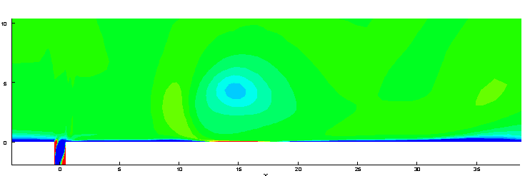
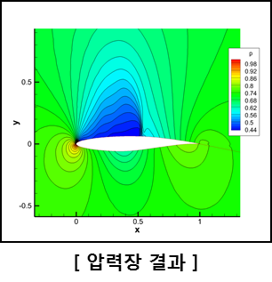
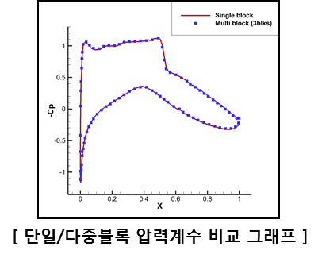
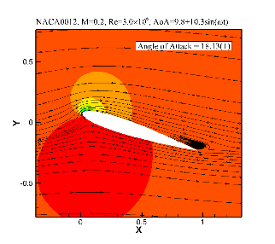
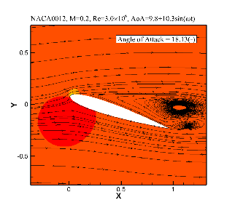
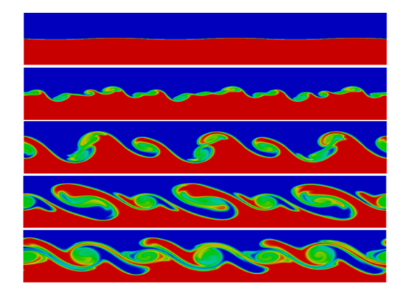
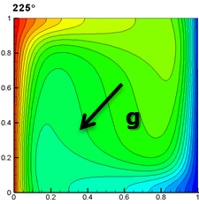
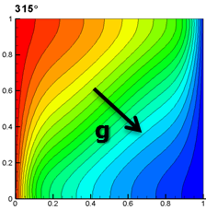
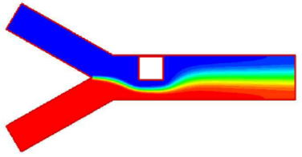
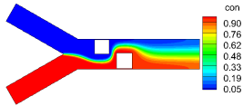
EDISON_CFD: Simulation Programs
Examples using Representative Simulation Programs
Compressible/ Incompressible Flow 1
Compressible/ Impressible Flow 2
Compressible Lam./Turb. Flow
Synthetic jet flow using multi-block incompressible N-S solver
Transonic flow over RAE2822 airfoil using multi-block compressible N-S solver
Flow over NACA0012 when increasing/decreasing AOA using dynamic analysis solver
Heat/Turbulent/ Stokes Flow
Duct Flow
Multiphase Flow
Natural convection flow depending on the direction of gravity using heat transfer solver
Y-channel flow depending on arrangement of obstacles using mixing channel flow solver
Kelvin-Helmholtz instability flow using free surface flow solver

Slide 10
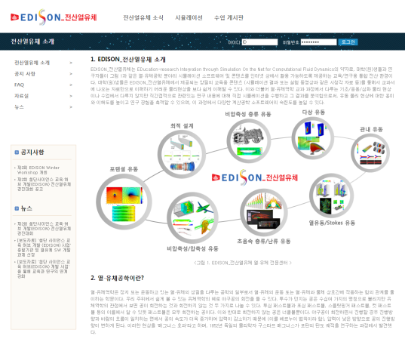
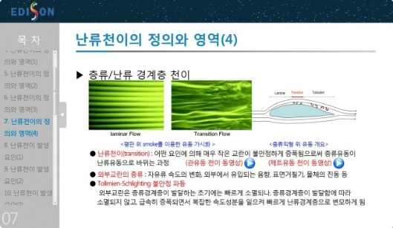
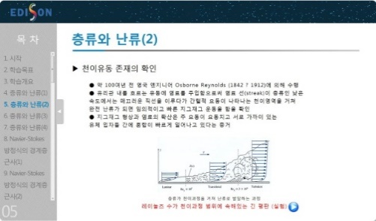
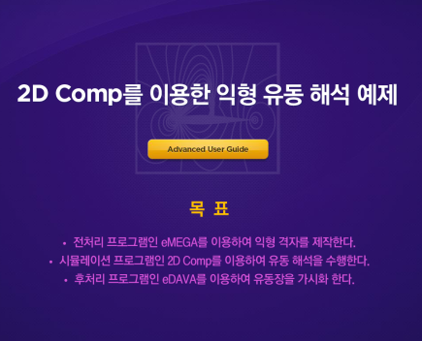
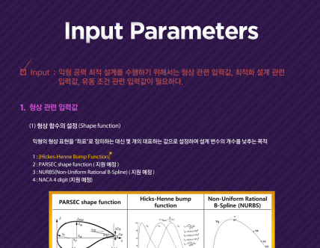
EDISON_CFD: Education Contents
Representative Education Contents
EDISON_CFD and thermo-fluids engineering
Understanding the laminar-turbulent transition
Analysis of differences between lam. and turb. incomp. flow and theoretical background of self-similarity solution
Introducing EDISON_CFD and thermo-fluids engineering
Understanding the transient process from laminar to turbulent flow
Understanding the background of boundary layer in laminar and turbulent incompressible flow
Interactive user manual for general- purpose simulation program
EDISON airfoil design manual
Introducing how to use general-purpose simulation program, pre/post-processor, and web portal
Introducing an optimization theory, a sensitivity analysis and a shape functions with design optimization of airfoil

Slide 11
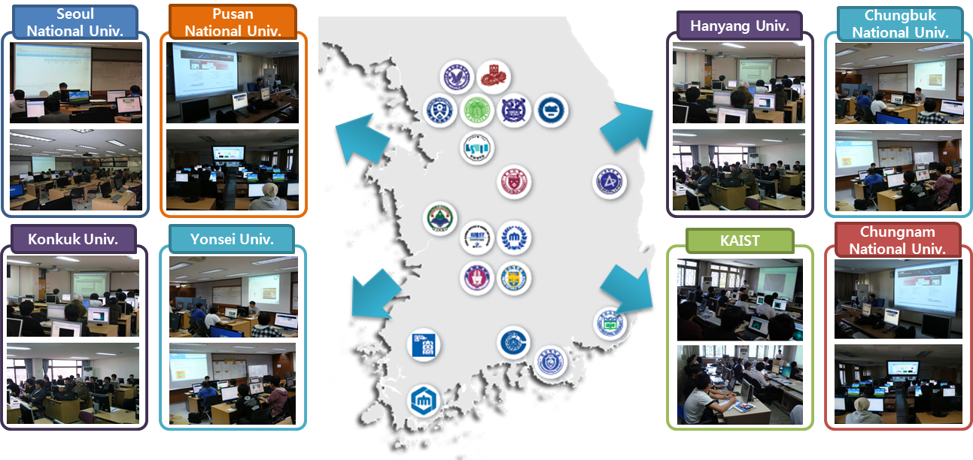
Utilization of EDISON_CFD in Education
The Summary of Utilization for Education in Thermo-Fluids Field
For undergraduate and graduate students → Performing CFD simulation using EDISON_CFD → Obtaining a deeper understanding, a capability to solve problems
2011 2nd semester~2012 1st semester: 16 colleges, 58 subjects, 1802 students
2012 2nd semester~2013 1st semester: 20 colleges, 68 subjects, 2294 students
2011~2013: 36 Universities, 126 Subjects, 4096 Students

Slide 12
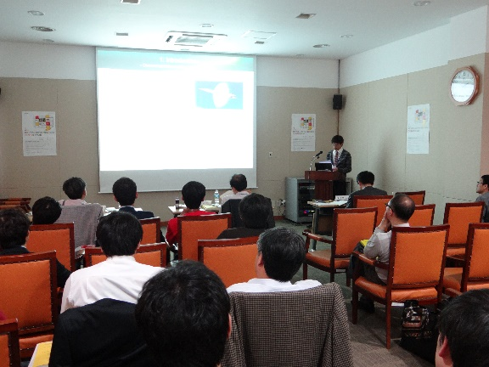
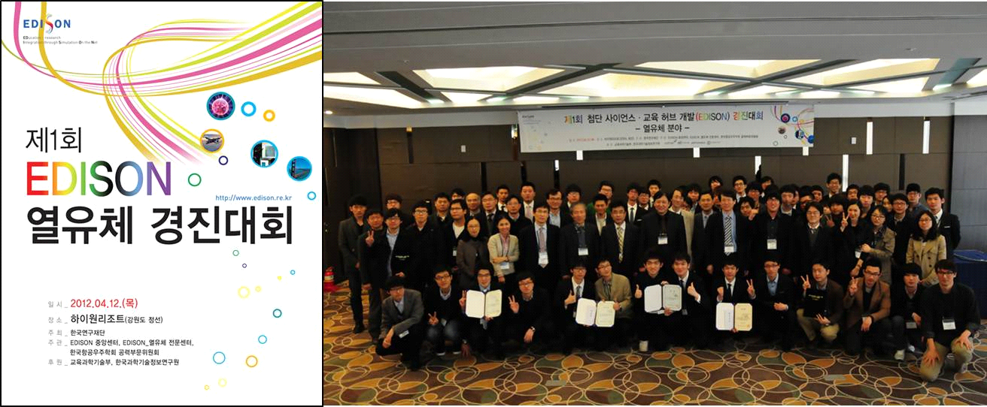
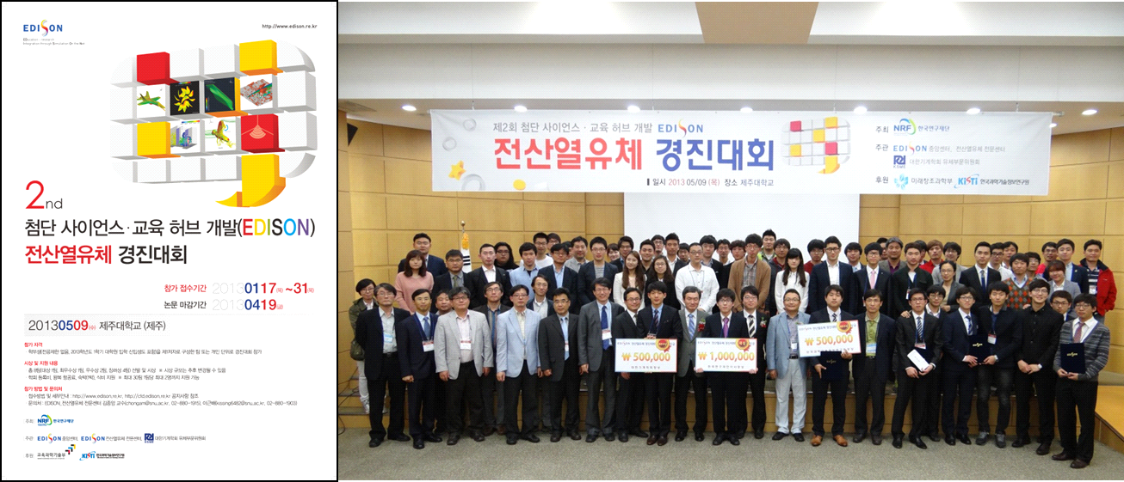
Utilization of EDISON_CFD in Education
EDISON Competition in Thermo-Fluids Field
To increase a capacity of undergraduate students for solving flow problems
To promote the utilization of EDISON_CFD
Participants present research on the self-selected topic using simulation programs in EDISON_CFD
8 teams are awarded

Slide 13
Thank you.

Slide 14
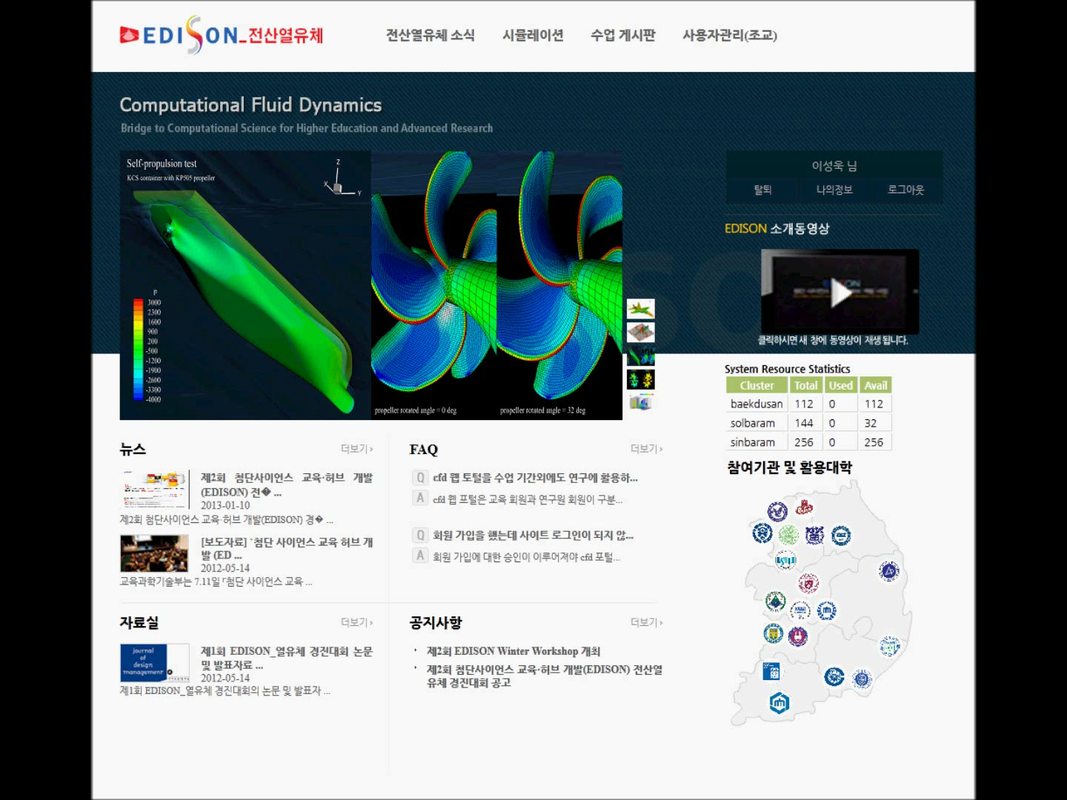
Demo

